Slide 1
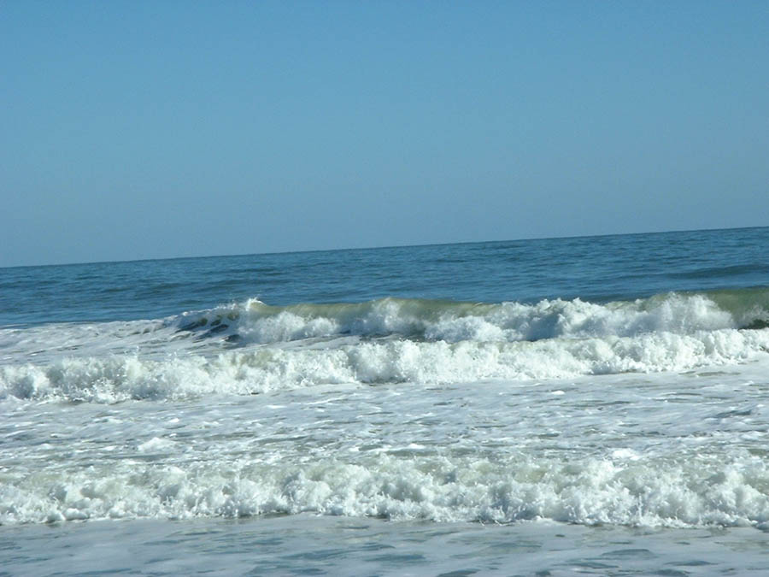
Introduction to physical oceanography & climate
EPS 131
Times: Monday, Thursday 14:30-16:00;
Location: University Museum, 24 Oxford - 105 (Daly Seminar Room)
Eli Tziperman
Museum building 456, 24 Oxford St
Tel: (617) 384-8381; eli@eps.harvard.edu
Office hours: Tuesday 2-3
TF: Charlotte Persson-Gulda, cpg@seas.harvard.edu
Tel, office: , office hours: please see course web page.
Please feel free to write/ call/ visit us anytime…
Announcements, notes, homework, solutions:
http://isites.harvard.edu/icb/icb.do?keyword=k80060

Slide 2
EPS131 logistics
Course requirements: Best 90% of Semi-weekly homework will constitute 40% of grade; Two class presentations & class demonstration of a fluid experiment (20%); Final (possibly a take home, 40%).
Needed preparation: APM 21a,b/ Math 21a,b; Physics 15 (or 11); no programming preparation expected, Matlab will be introduced & used
Matlab Intro sessions: this week! Please see course web page
Textbook(s): Knauss, introduction to physical oceanography, 2nd edition, 1996, Also useful: The open university team: (1) Ocean circulation, 2nd ed, 2002; (2) Waves, tides and shallow water processes, 2nd ed, 2002. (3) Kundo & Cohen, Fluid mechanics. 2nd ed ’02; (4) Stewart, on-line physical oceanography book.
Course web page: homework, announcements, student presentations …
http://isites.harvard.edu/icb/icb.do?keyword=k80060
Teaching notes with links to on-line sources for lectures:
http://www.seas.harvard.edu/climate/eli/Courses/EPS131/2012spring/teaching-notes-intro-physical-oceanogr.pdf

Slide 3
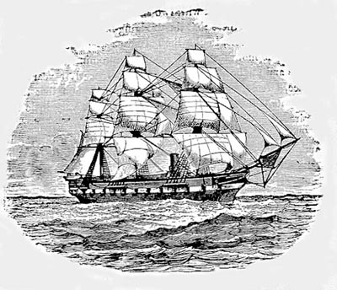
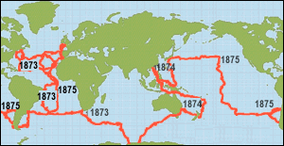
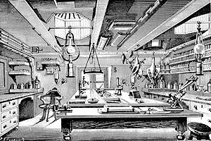
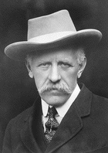
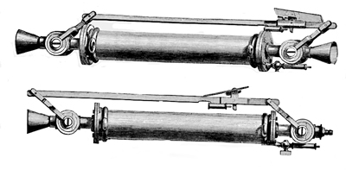
Origins…
H.M.S. Challenger 1872-6
Nansen
Oceanography + Nobel peace prize…
Nansen bottles

Slide 4
Outline
The basics, what we observe:
  Coriolis force
  Ocean temperature, salinity, currents
  Gulf stream, variability, rings, eddies
  Waves, tides, Tsunamis
How we observe: Ships, satellites, airplanes, moorings, current meters, buoys, floats, sound waves...
How we try to understand it all: From theory to data analysis; From Pencil/ paper to super computers
Oceans and climate: Monsoons, Thermohaline circulation; El Nino; abrupt climate change, Glacial cycles; global warming, …

Slide 5
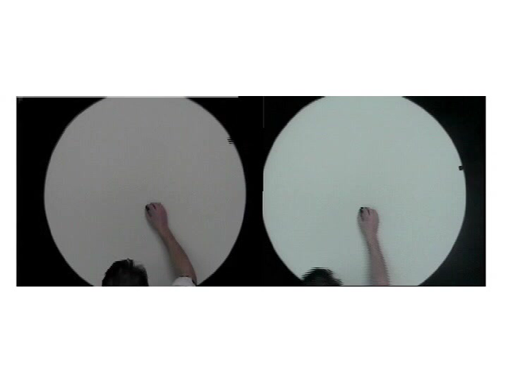
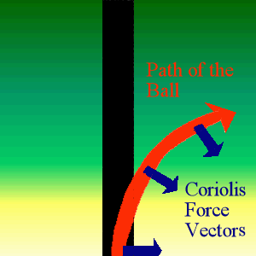
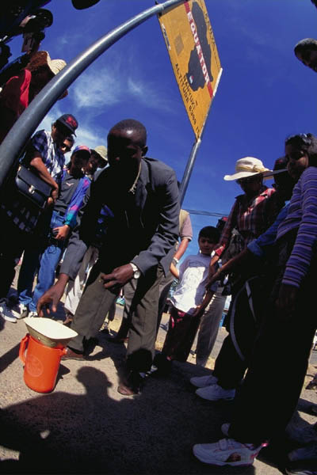
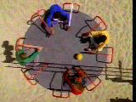
Coriolis force
(J. Marshall, MIT)
Coriolis force acts to the right
of the motion in the northern
hemisphere, and to left in the
southern hemisphere.
Toilet Bowl Water Twirls Clockwise?
It’s not the Coriolis force…

Slide 6
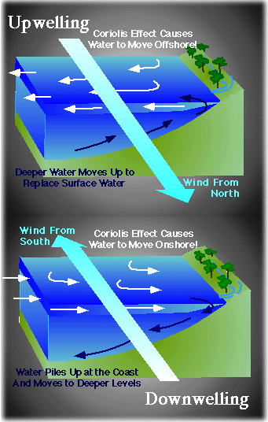
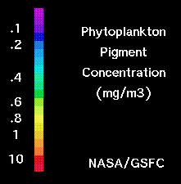
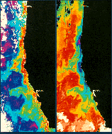
Coriolis force, Coastal Upwelling and fisheries
Currents created by winds, are diverted by the Coriolis force, resulting in water being carried away from shore. Deep, cold water rises to replace these waters, resulting in coastal upwelling.
The rising water is rich in nutrients, attract plankton & create rich fisheries.
Temperature and chlorophyll concentrations along the California coast

Slide 7
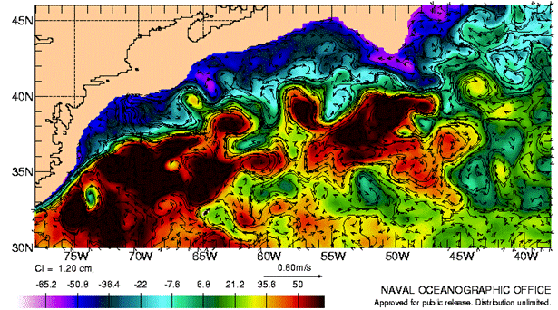
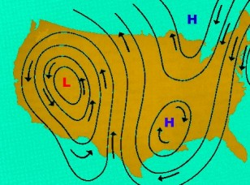
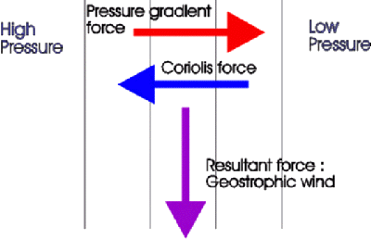
Coriolis force, highs/lows, ocean surface “topography”
Air/water does not flow from high to low pressure…
Instead, Coriolis force causes flow along
equal pressure lines
surface height difference across the
width of the Gulf Stream (50km) is
about one meter (!)

Slide 8
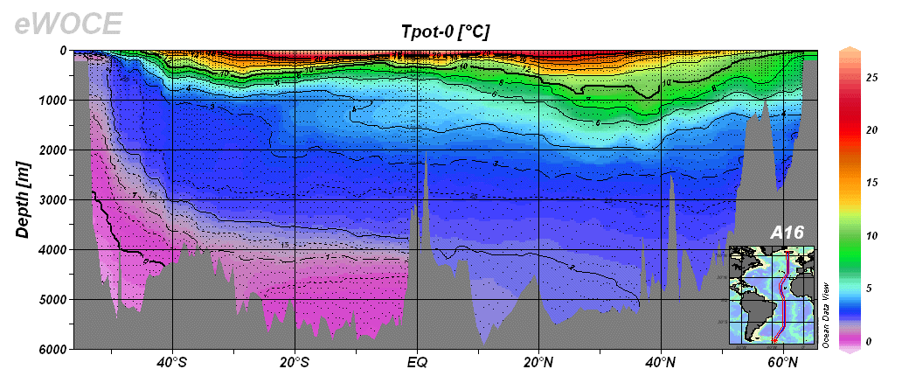
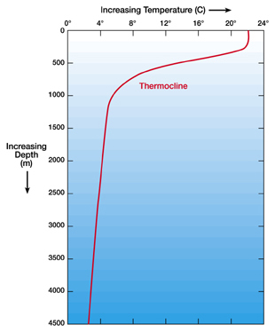
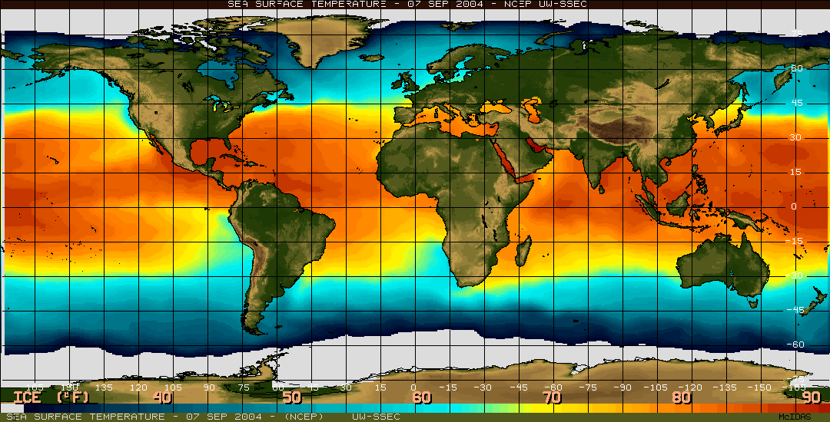
Temperature
Cold water is nearest surface at equator, which is the warmest area…
North-South
Section.
Bottom
temperature
Is near 0 deg
even at Equator…
Horizontal map,
Sea surface
temperature
Mixed layer
Thermocline

Slide 9
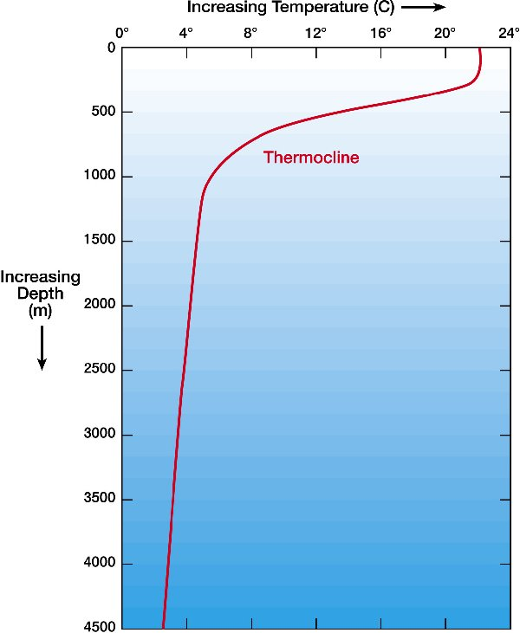
Temperature
What sets the equator to pole temperature gradient?
Why is the deep ocean so cold?
Why is the cold water closest to the surface at the equator of all places?
What sets the bowl-shape of the thermocline?

Slide 10
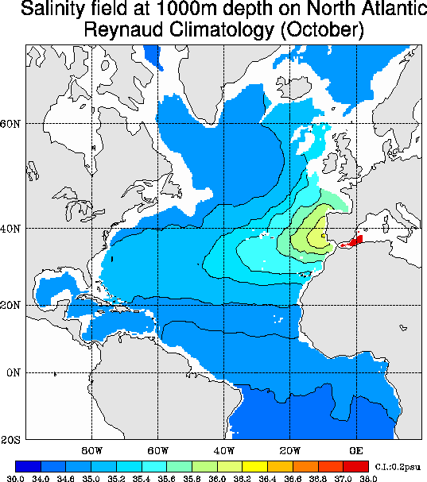
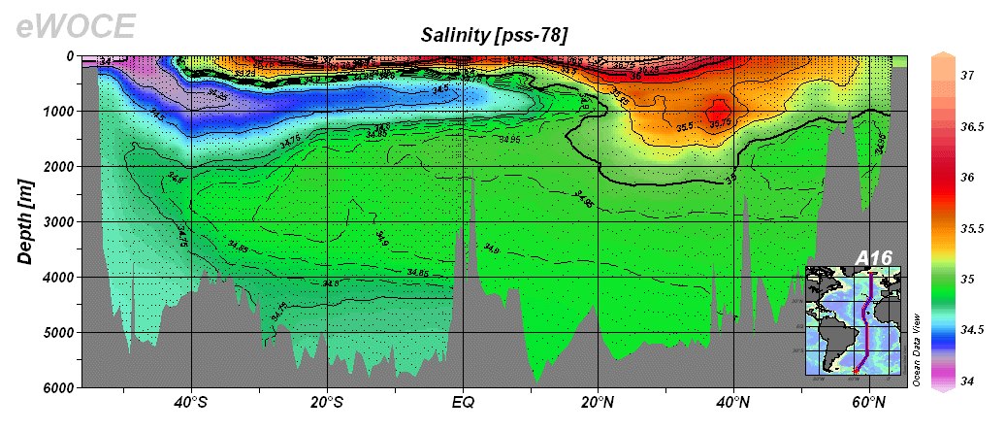
Salinity
?? kg salt/meter cubed
Evaporation, precipitation, ice melt...
Salinity along Atlantic ocean, vertical axis exaggerated by 1000s

Slide 11
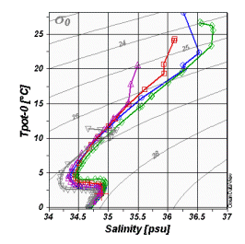
Salinity
Why is the Atlantic saltier than the Pacific?
Why does surface water sink to the deep ocean in the North Atlantic and not in the North Pacific?
Why do temperature-salinity data fall on such a narrow plot:

Slide 12
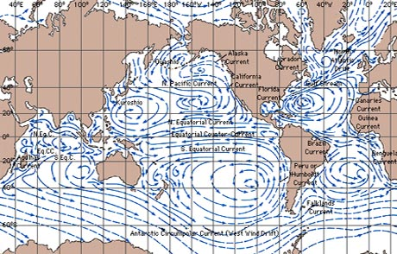
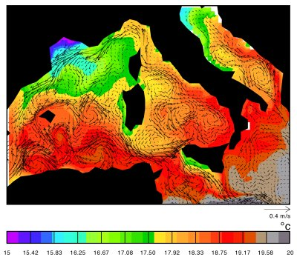
Currents
global circulation schematic & west Mediterranean snapshot

Slide 13
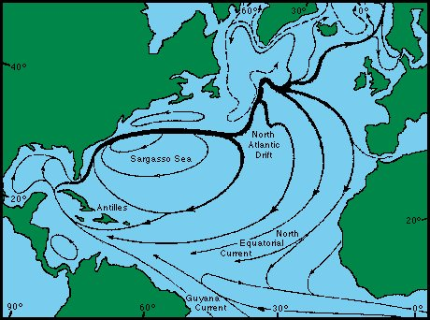

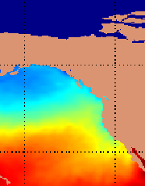
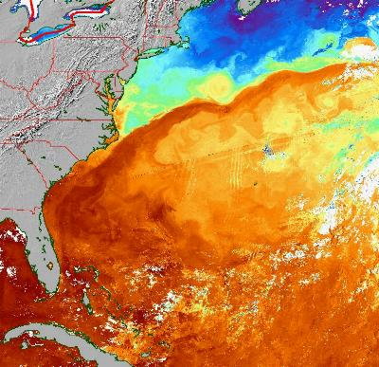
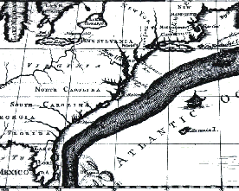
Gulf Stream/ Kuroshio: western boundary currents
(Strong western vs weaker eastern boundary currents)
Note east-west
Asymmetry!
1753-1774, deputy
postmaster general,
North America
Cold California Current: 2M m^3/sec; 0.1m/s
Warm Gulf Stream: 150 M m^3 /sec, 1-2m/s
His cousin’s map of a
feature known for 250 yr

Slide 14
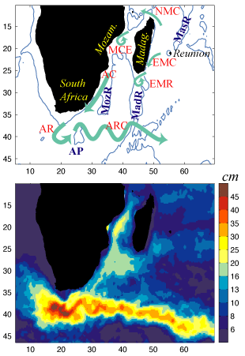
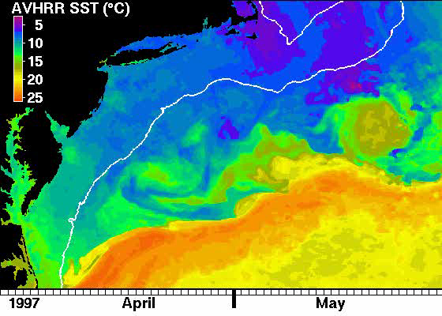
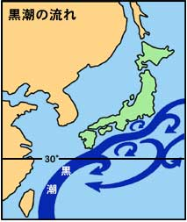
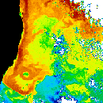
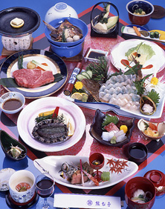
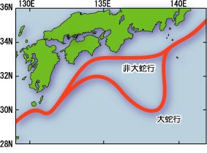
Western boundary currents: rings, enhanced eddies
Gulf, Kuroshio, Agulhas, Somali, Brazil, East Australia,…
Agulhas current
Kuroshio, west Pacific
East Australia

Slide 15
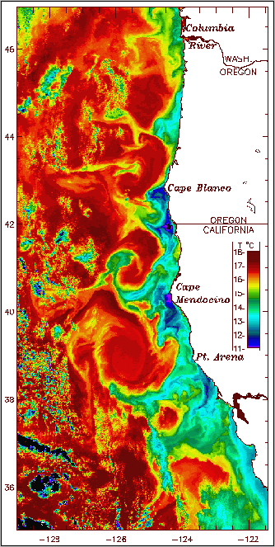
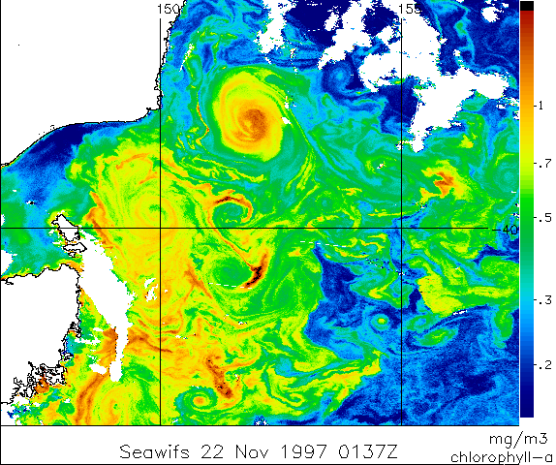
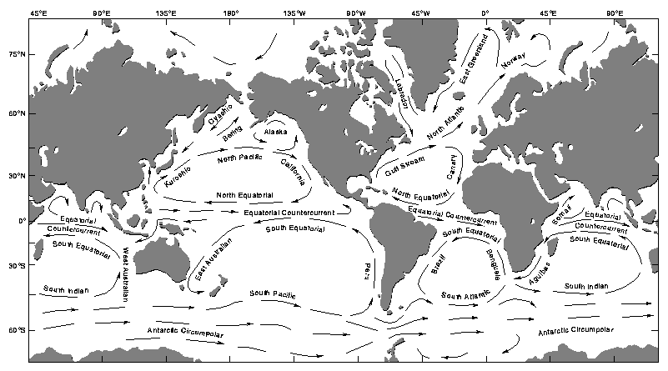
Ocean Eddies
1970s: nothing is steady in ocean
There is turbulence in the ocean on all scales from mm to 100s km. The large turbulent features are “eddies”
Similar to weather systems, but X10 smaller; move/ change much slower (weeks & months instead of days)
Chlorophyll-a from ocean color,
SeaWIFS, East Australia Current
Temperature, US east coast

Slide 16
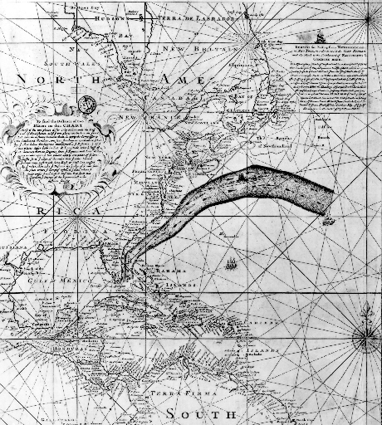
Currents
What drives the ocean currents?
Why are there narrow strong currents near the west margins of all oceans, not east?
What causes the ocean large scale turbulence: 20-200km eddies?
Are the eddies like atmospheric weather? Can they predicted? Who might want to predict them?
How do the eddies interact with the large scale circulation?
1769-1770,. Gulf Stream, Benjamine Franklin for the mail service from England…

Slide 17
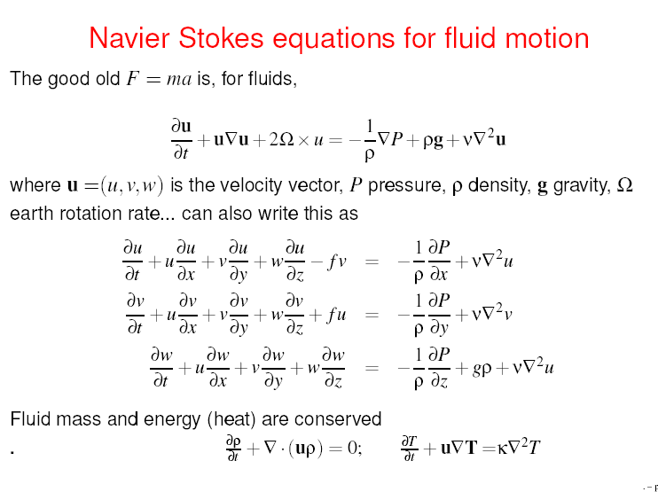

Slide 18
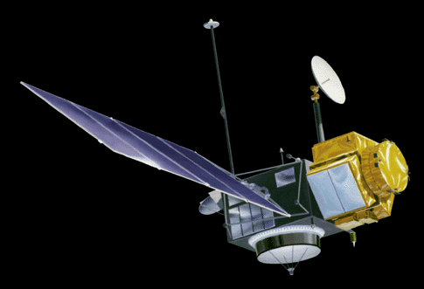
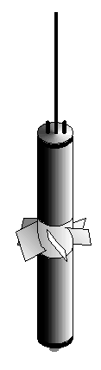
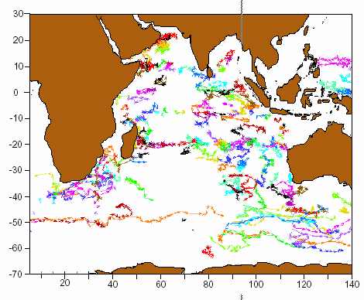
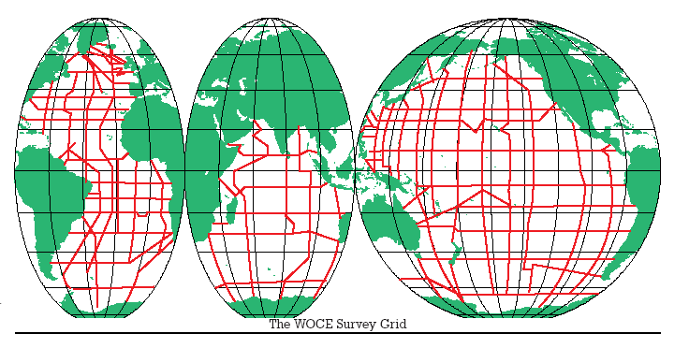
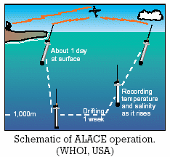
Observing the oceans
TOPEX
From the Challenger (1870s) to the World
Ocean Circulation Experiment (WOCE/1990s)
Satellites: Altimeter (TOPEX), SST,
wind (QuickScat), chlorophyll, sea ice…
Floats, moorings…, CTD, bottles, …
RAFOS
float
Challenger
WOCE
ALACE float trajectories

Slide 19
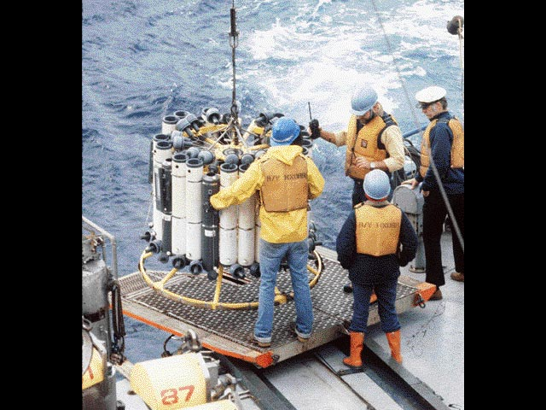
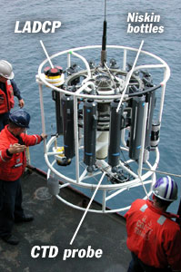
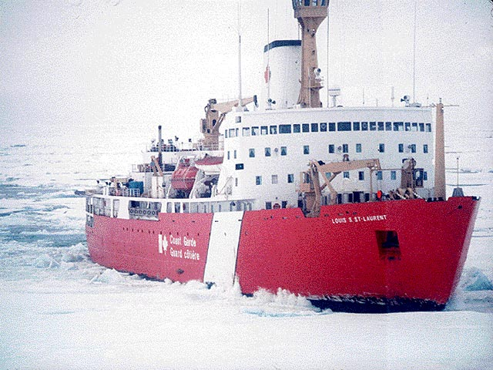
Ships, satellites, moorings, floats
CTD, (field trip to cape code and WHOI…)

Slide 20
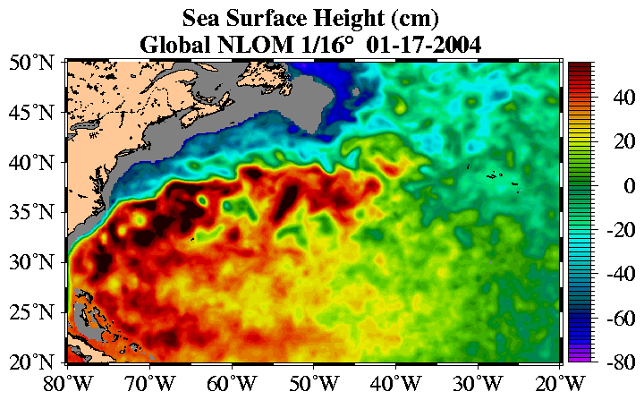
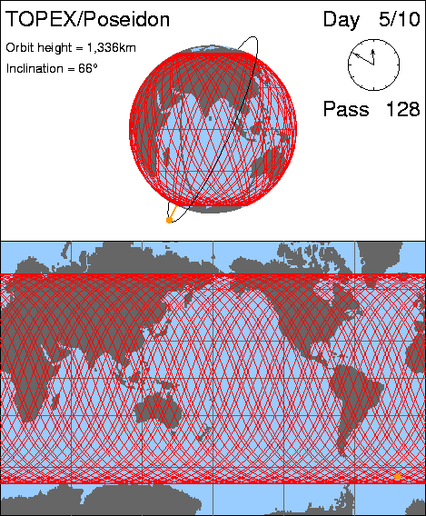

Ships, satellites, moorings, floats
Altimeter: radar measuring ocean surface height

Slide 21


Ships, satellites, moorings, floats
More: sea surface temperature (infrared), scatterometer (winds), & more…

Slide 22



Ships, satellites, moorings, floats

Slide 23



Waves, Tides, Tsunami
There is much more to waves than just surface waves at the beach…
Tides are surface waves, and so are Tsunami
Fu Chuan-Fu & friends

Slide 24


Waves
What determines the relation between the wave length and period for wind waves?
Why do waves break?
Why do waves always arrive parallel to the coast?
What determines the wave height?
Can we predict surface waves?

Slide 25



Waves, Tsunami, Tides
Caused by undersea earthquakes, landfalls
propagate as undetectable low-amplitude surface waves
speed=
slows down and height increases to 10s m when approaching shallow coast.
1992, Indonesia, 3-4m waves

Slide 26
Tsunamis
What causes Tsunamis?
What sets their speed of propagation?
Why can’t they be seen in the open ocean, yet reach huge heights when reaching the coast?
Warning systems?

Slide 27



Waves, Tsunami, Tides
Phase of
semi-diurnal tide

Slide 28


Tides
What causes them?
Why two a day?
Why so large in some places and so small in others?
Mont-Saint-Michel (town of Normandy - France)

Slide 29



Internal waves
Wave motions that affect the thermocline instead of the surface. Have wave lengths of 100-1000km, amplitude of 10s meter
Internal waves showing as calm bands (slicks) at ocean surface

Slide 30

Internal waves
How are they formed?
What sets their period, speed of propagation?
What is their role in causing mixing in the ocean?
How are they influenced by tides, bottom topography?

Slide 31
Climate!
Thermohaline circulation
Abrupt climate change
El Nino
Future climate change

Slide 32


Thermohaline circulation & Global climate
THC carries 20M meter cubed of water
per second (all rivers combined: 1M)
Carries a significant part of the heat transport
from the equator to the pole
Driven by temperature differences, “braked” by salinity
May vary on a time scales of decades, affecting European climate
Its past variations may have caused abrupt climate change. “Day after tomorrow…”

Slide 33




The THC and past climate
Europe's Little Ice Age, 14th Century; Pieter Breugel the Elder.
Norse ruins from Brattahlid, Greenland. “Eirik the Red,” exiled from Iceland for his crimes, 980 A.D., set sail and spotted “Greenland”. 1,000 Scandinavians lasted until 1480 A.D., died by starvation due to nasty winters.

Slide 34

Thermohaline circulation
Given rain and evaporation which affect the ocean salinity, can we find more than one climate state for the THC? (yes, Stommel 1961)
Can climate switch abruptly between these possible states?
Can such a switch be triggered by global warming?
What would be the consequence of such a switch to earth’s climate?
surface
bottom
Equator
45N
N. Pole

Slide 35

http://www.ngdc.noaa.gov/paleo/slides/slideset/index19.htm
Abrupt climate change

Slide 36

Dansgaard-Oeschger events

Slide 37


Abrupt past climate change
(due to thermohaline circulation changes?)
 | Global warming | D/O & Heinrich events
Amplitude | 0.75C | 10C
Duration of change | 100 years | 20 years

Slide 38

El Niño

Slide 39

Development of an El Nino event: a comparison of two major El Nino events:

Slide 40


Observations: system has two “modes”:
The (warm) child and the (cool) girl…
El Nino:
A El Niño conditions
La Nina:
B La Niña conditions
The major players: Easterly Trade Winds and Thermocline, thermocline and sea surface temperature.

Slide 41
Observations: The irregular variations between El Nino and La Nina limit predictability
Period 3-6 years
recent enhancement or decadal variability?

Slide 42

Back to the future

Slide 43

Ocean’s role in global warming
Sea level rise:
  Thermal expansion
  Melting
Abrupt climate change:
  sea ice (show two animations!)
  thermohaline circulation
Absorbing ½ of emitted CO2
Absorbing heat, slowing warming
Ocean acidification, corals

Slide 44
Summary
Basics:
  Temperature, salinity, density
  Currents, Coriolis, coastal upwelling
  Western boundary currents, general circulation, eddies
Waves: surface, internal, tides, Tsunamies
Observations: satellites, floats, moorings, ships
Climate: Thermohaline circulation: climate’s conveyer belt; El Nino; abrupt climate change; future climate

