Slide 1
The Lag Between CO₂ and Temperature
Becca Stout, Julia Henry, Jack Deschler, Michael Waldron

Slide 2
Why does it matter?
"An article in Science magazine illustrated that a rise in carbon dioxide did not precede a rise in temperatures, but actually lagged behind temperature rises by 200 to 1000 years. A rise in carbon dioxide levels could not have caused a rise in temperature if it followed the temperature."
-Congressman Joe Barton (R-Texas)

Slide 3
Ice Coring Review
Oldest continuous record
800k years in Antarctica
Antarctic points of interest
EPICA Dome C: 800k years
Vostok: 400k years
Interpret data by understanding formation process

Slide 4
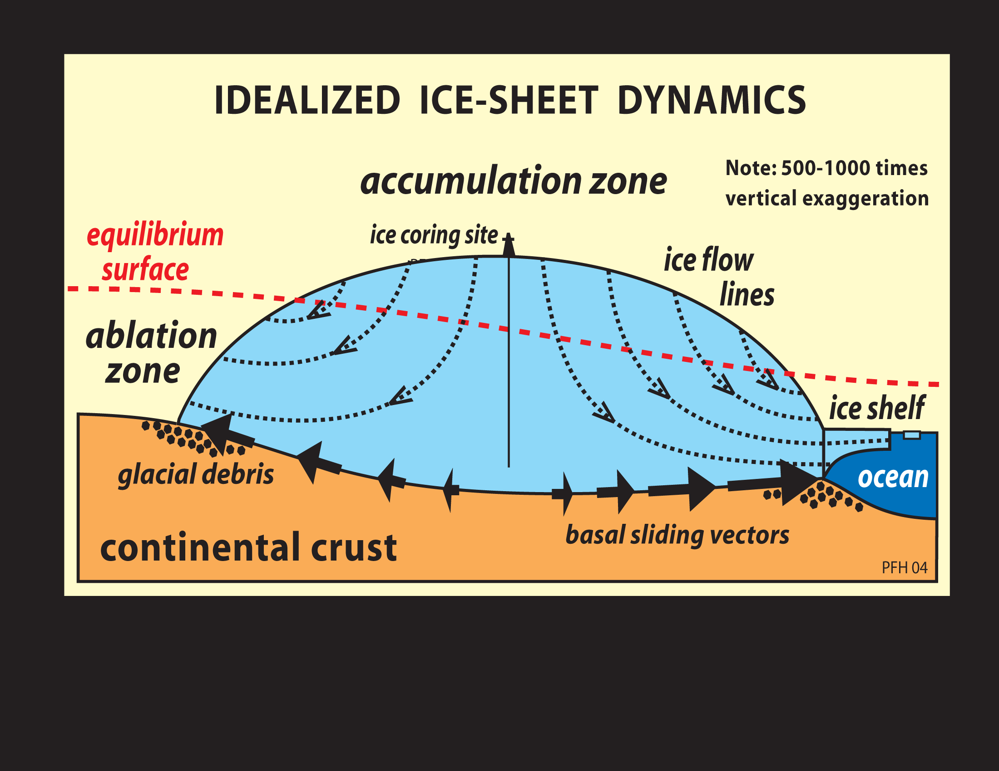
Why Ice Domes?
In domes, stratigraphy is preserved
Accumulation zone: net mass gain from precipitation, avalanches, windblown snow
Ablation zone: net mass loss from surface melt, avalanches, windblown snow, etc
Low impurities, high accumulation rate, limited ice flow

Slide 5
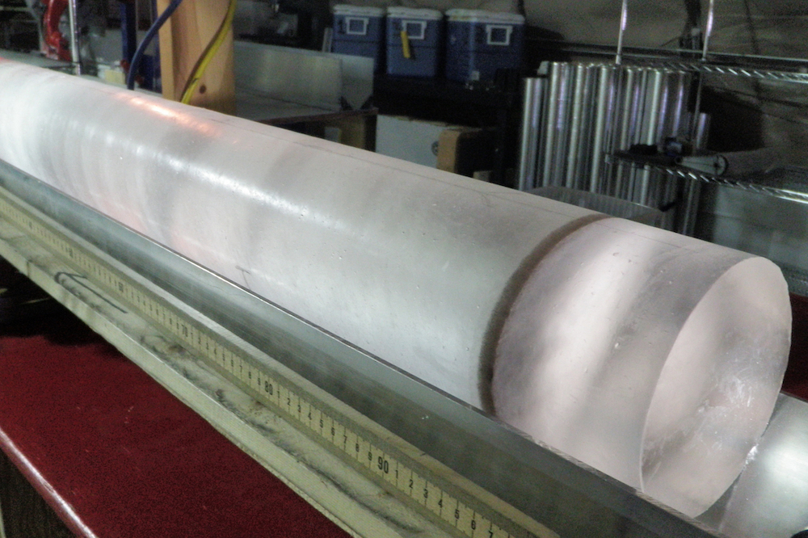
Ice Cores
Seasonal differences in the snow properties create layers
Layers in Antarctic thinned by flow
Used to determine accumulation rate, precipitation rate, melt layers
Darker winter layers
Lighter summer layers
Ash layers = volcanic activity

Slide 6
Critical Processes that Influence Lock In Depth
Diffusive zone variance
Accumulation rate
Wind speeds
Snow/ice flows
Physical structure
Grain size
Layering
Water molecules, gas molecules not coeval
Diffusive Zone
Lock-in Depth

Slide 7
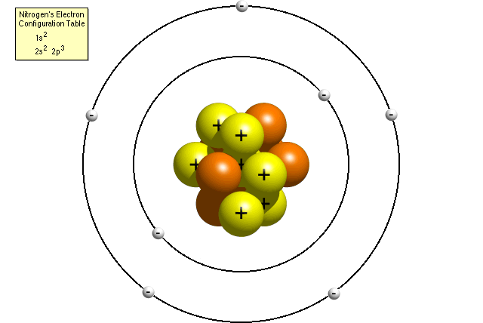
Isotopes Differ Depending on Number of Neutrons
More Neutrons ⇒ Heavier Atom/Molecule
Electrons
Protons
Neutrons

Slide 8
Fractionation
N₁₄, O₁₆, Ar₃₈, Ar₃₆
Gravitational
Heavier isotopes sink relative to lighter isotopes
Thermal
Snow insulates
Heavier isotopes enriched in colder portion
Less influential
Scale: ~0-2 ppt
N₁₅, O₁₇, O₁₈, Ar₄₀
Lock-in Depth

Slide 9
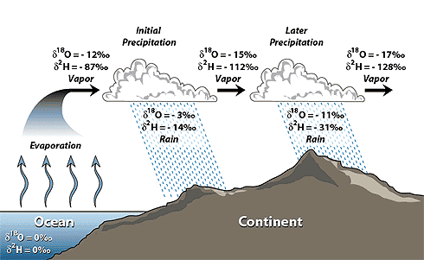
Rayleigh Fractionation
Oxygen isotopes (¹⁶O and ¹⁸O), Hydrogen isotopes (¹H and ²H)
Evaporated water moves towards the poles
Heavy equatorial waters
Light polar ice
δD and δ¹⁸O of high latitude precipitation decrease as temperature decreases
Foram data: low δ¹⁸O values indicate high temperatures
Ice cores: low δ¹⁸O and D indicate low temperatures

Slide 10
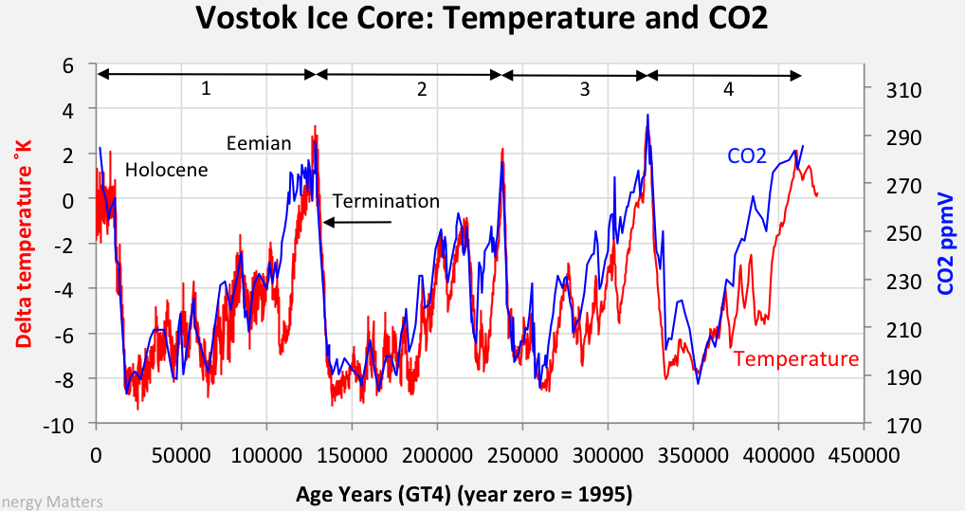
Temperature and CO₂ Records
Temperature
δD and δ¹⁸O indicate surface temp at middle and high latitudes
Isotopic composition of melted ice cores
CO₂, CH₄, N₂O
Gas bubbles
Well-mixed (global indicator)
Must account for age difference

Slide 11
Bubbles in Ice Core

Slide 12
Timing of Atmospheric CO2 and Antarctic Temperature Changes Across Termination III
Nicolas Caillon
Engineer at Institut des Géosciences de l'Environnement
Co-authors
Jeffrey P. Severinghaus
Jean Jouzel
Jean-Marc Barnola
Jiancheng Kang
Volodya Y. Lipenkov

Slide 13
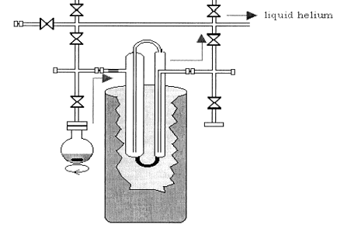
Caillon et al.: Measuring Argon Isotopes
Use Argon (gas) as a proxy for temperature in Vostok core
Find Argon content in air bubbles using wet extraction method
Ice is heated under a vacuum → melts and releases gases from the bubbles
Slow refreezing of the water forces the gases into an extraction chamber
Gases condensed or compressed
Compare to CO₂, CH₄, and 𝝳¹⁸O

Slide 14
Terminations
Termination 1: Parennin
Termination 3: Caillon
Periods of rapid climate change
Transition from glacial climates to interglacial climates

Slide 15
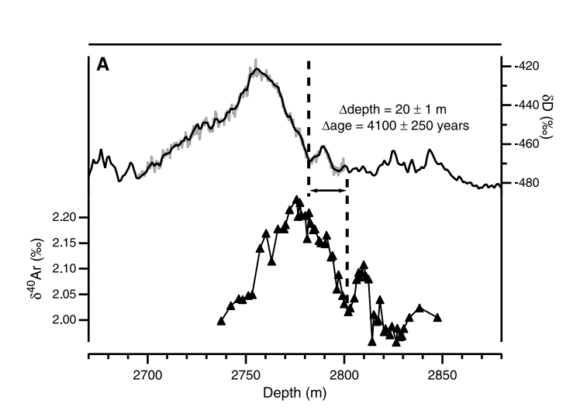
Matching Argon and Deuterium Records
More depleted (lower temp)
Deuterium
Not perfectly correlated
Argon-40

Slide 16
Argon as Temperature Proxy
Temperature from Deuterium
Deuterium typically used to determine temperature
Argon as another proxy
Reasonable assumption?
Unadjusted R² = .85
Temperature and 𝝳⁴⁰Ar are very well correlated
Argon

Slide 17
Convective and Diffusive Zones
Negative firn depth = nonphysical
Convective: mixes with atmosphere
Diffusive: mixes within snow
Close-off depth: no more mixing
DCH likely controlled by temperature

Slide 18
Argon-GHG Comparison
Use of Argon as temperature proxy makes comparison to other gases more accurate
Correlated errors?
Key assumption - no lag of Argon behind temperature
“The following conclusions are based on [this assumption] and so they must be considered tentative.”
How long does it take for ice column to respond to changing T?
Crosses = additional CO₂ records from Fischer et al.

Slide 19
Vostok Record of 𝝳⁴⁰Ar: Shows 800 ± 200 year lag
Shift of 800 years of 𝝳⁴⁰Ar to best match the correlation of the datasets
Short in comparison to 5000 year period of T increase
CO₂ rise precedes Northern Hemisphere deglaciation
CO₂ amplifying initial warming?
Uncertainty +/- 200 years
Adjustment (100 years)*
Ice accumulation (160 years)*
*Deviations not additive

Slide 20
Milankovitch Cycles: Driving Initial Warming?
Changes in:
Tilt of axis (Obliquity)
“Wobble” of axis (Precession)
Ellipticity of orbit (Eccentricity)

Slide 21
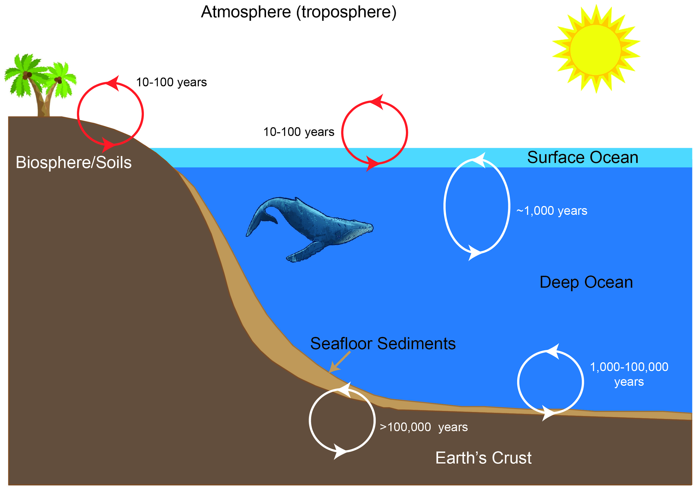
Ocean Mixing: A possible explanation of the lag?
Takes ~1000 years, or about Caillon’s time lag
Mixing due to winds, heat fluxes, evaporation, and salinity fluxes
Surface (0-200m):
warm, low density
Deep ocean: Falling temperature, increasing density
Mixing by winds and storms

Slide 22
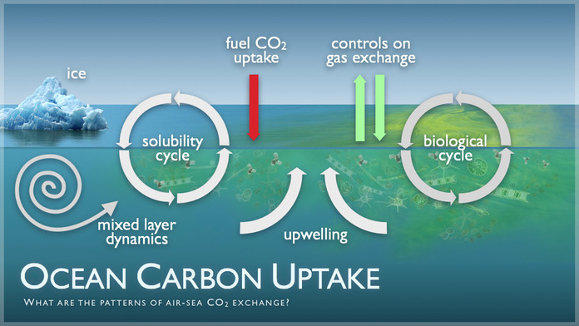
The link between CO2 and Ocean Mixing
Orbital changes increase temperature
ocean temperature rises
warming
oceans release CO₂ into the atmosphere

Slide 23
Synchronous Change of Atmospheric CO2 and Antarctic Temperature During the Last Deglacial Warming
Co-authors:
V. Masson-Delmotte
P. Köhler
D. Raynaud
D. Paillard
J. Schwander
C. Barbante
A. Landais
A. Wegner
J. Jouzel
Frédéric Parrenin
Junior Scientist at Centre Nationnal de la Recherche Scientifique (CNRS) in France

Slide 24
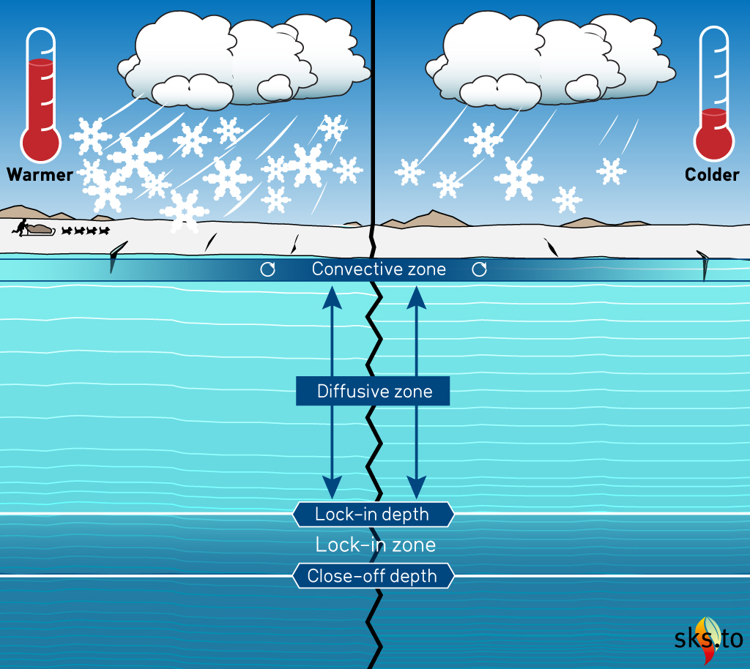
Parrenin et al. Methodology
Termination I ice core in EPICA Dome C (EDC)
𝛅¹⁵N data to determine LID and ΔDepth using constant firn density & vertical thinning function
Assumes no convective zone
Verified with two methods
Event synchronization
Seesaw methods

Slide 25
Parrenin uses data from Termination I
Note: Parrenin uses data from EPICA Dome C (EDC), not Vostok

Slide 26
Event Synchronization for Δdepth
Δdepth known at EDML
Volcanic events synchronize ice
CH₄ events synchronize gas
Mark the beginning of glacial terminations
Use these markers to determine Δdepth at EDC

Slide 27
Estimation of ΔDepth along EDC ice core
Densification model diverges from all other models
Used by Caillon et al.
Parrenin methodology confirmation
𝛅¹⁵N data from EPICA Dome C ice core
What are these?

Slide 28
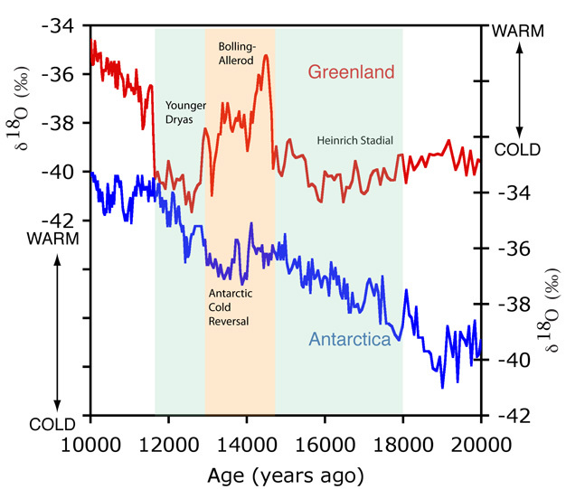
Bipolar Seesaw Hypothesis
Observation that synchronous temperature maxima and minima occur at the poles
Greenland maxima at Antarctic minima and vice versa
Parrenin et al.: possible to construct “Greenland-like” temperature series from EPICA Dome C records
Greenland and Antarctica out of phase

Slide 29
Bipolar Seesaw: Tie-in Points
Bipolar Seesaw hypothesis allows three more delta depth estimates
Error bars are 1SD
Serve as verification of 𝛅¹⁵N methodology
Review previous delta depth estimations

Slide 30
Climate Series Comparison
Holocene onset (lag)
Younger Dryas onset (no lag)
Bølling Oscillation onset (lag)
TI (no lag)
Antarctic Temperature Series (ATS) and aCO₂ highly correlated
Pearson R²= .993
Results in agreement with a 0-400 year aCO₂ - Temperature lag for TI
Another common mechanism?
Lags potentially due to diffusion in gas recording process (aCO₂)
Key
Deuterium
ATS
aCO2
rCO2
aCH4
dO18

Slide 31
The Contrast between Caillon and Parrenin
Caillon | Parennin
Vostok ice cores, Termination III | EPICA Dome C, Termination I
Uses Argon as proxy for temperature | Uses synchronization for delta depth
Gas-gas comparison | Gas-ice comparison
Lag of ~800 years during Termination III coincides with deep ocean mixing | CO₂ does not actually lag temperature during Termination I

Slide 32
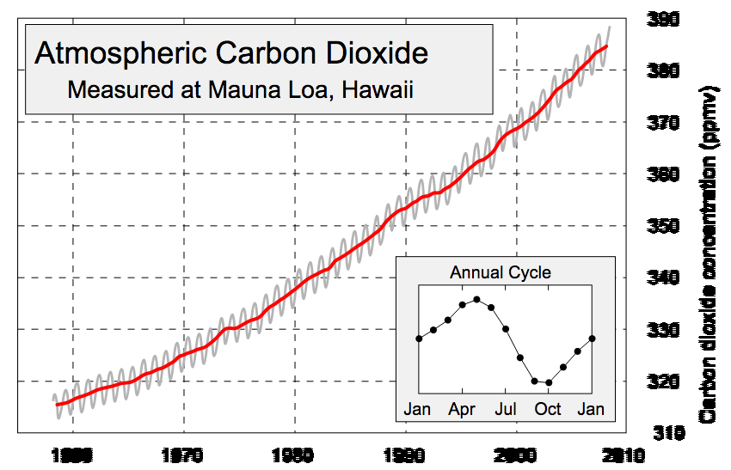
Causality Between CO2 and Temperature?
Neither Caillon nor Parennin can demonstrate clearly that a rise in CO₂ causes a rise in temperature
Correlation vs. causality
Seasonal variations in CO₂ and temperature

Slide 33
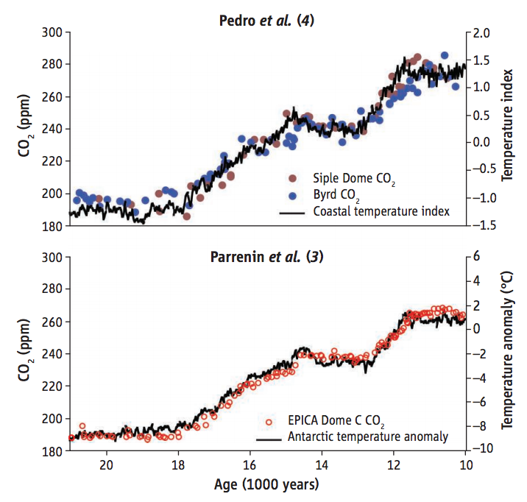
Verifying Parrenin et al.
From Brook (2013)
Both Pedro et al. and Parrenin et al. find that CO₂ and temperature were tightly coupled during the last deglaciation (Termination I)
Regional Antarctic temperature
Independent methods and data
Pedro uses a coastal core, Parrenin used an inland core

Slide 34
CO₂ and Temperature are Tightly Coupled
"An article in Science magazine illustrated that a rise in carbon dioxide did not precede a rise in temperatures, but actually lagged behind temperature rises by 200 to 1000 years. A rise in carbon dioxide levels could not have caused a rise in temperature if it followed the temperature."
-Congressman Joe Barton (R-Texas)
Do we have clarity?
Why does it matter?

